Slide 1
Evaluating Persistent Memory Range Indexes

Slide 2
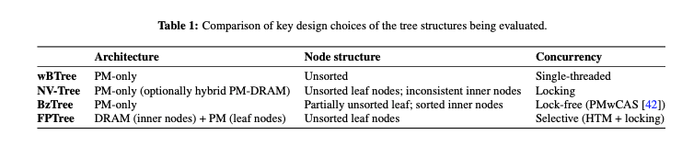
Introduction

Slide 3
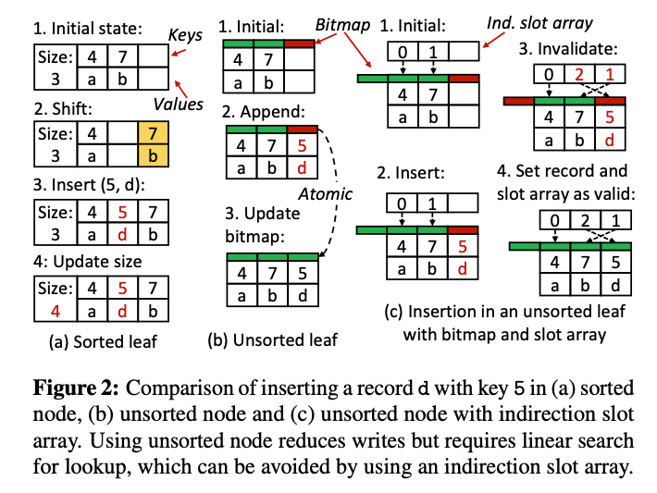
Write-Atomic B+-Tree
Single-Thread
Unsorted Leaf Node (save expensive PM write), Fig 2a
Out of place write with bitmap (Atomic);
Indirection slot array (enable binary search) Fig 2c;
Logging 4 more complex ops (split)
The n-th array element point 2 the
n-th snallet key [index]

Slide 4
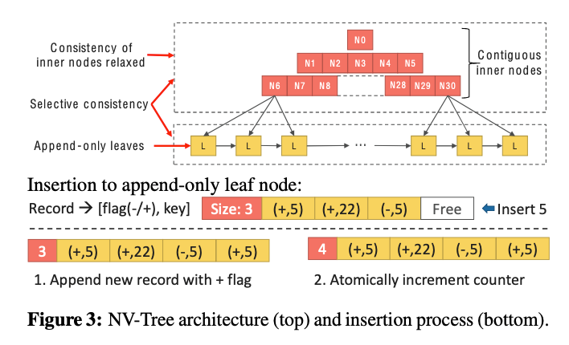
NV-Tree
Selective consistency (enforce leaf node consistency);
Reduce Cacheline flushes;
Recovery Inner node after crash;
Append only Write; (Leaf Counter)
Write with positive flag;
Delete with negative flag ;
Read: Scan backward 2 find the latest version;
Inner node stored contiguously;
Inner nodes are immutable; (lock-free inner node)
Rebuilt in Sparse way (avoid frequent split) cause high mem footprints

Slide 5
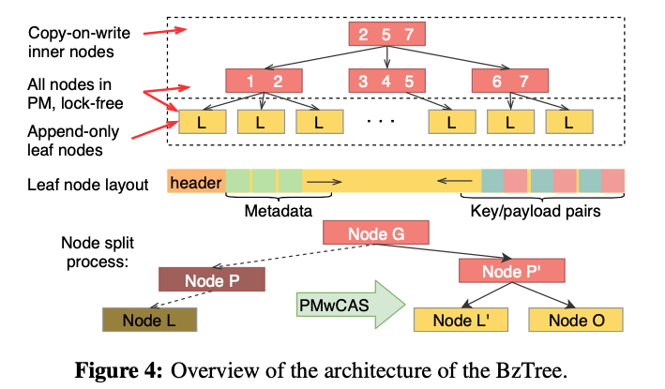
Bz-Tree
Lock-free with PMwCAS
PMwCAS allows atomically change multiple 8-byte PM words in lock-free manner with crash-consistent
All node in PM;
Inner node are immutable (cow), except update to exist child pointers;
Sorted inner node;
Leaf node contain sorted area & unsorted area;

Slide 6
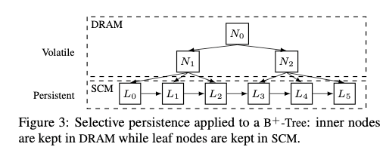
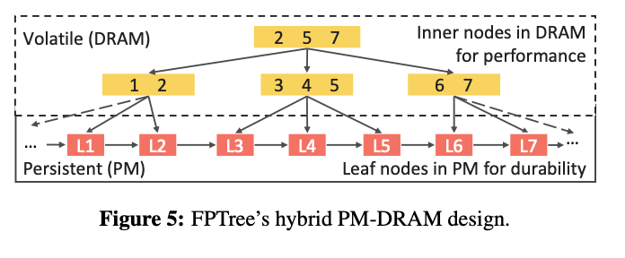
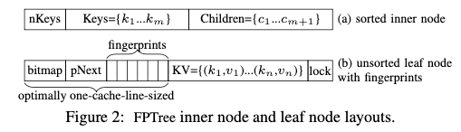
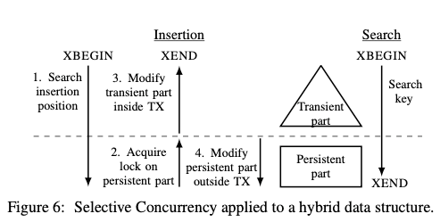
FP-Tree
Use both DRAM and PM;
FPTree trades recovery time for higher runtime performance
fp accelerate search
Unsorted leaf node an bitmap;
HTM & persistence primitives
selective concurrency

Slide 7
Environment
Software
PMDK
Workloads
uniform key distribution
a skewed key distribution
Hardware
Intel Xeon Platinum 8260L CPU,
1.5 TB of Optane DC PM (6 × 256 GB DCPMMs)
96 GB of DRAM (6 × 16 GB DIMMs).
The CPU has 24 cores (48 hyperthreads),
36 MB of L3 cache, and is clocked at 2.40 GHz.

Slide 8
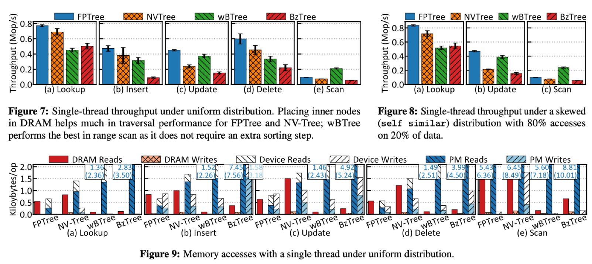
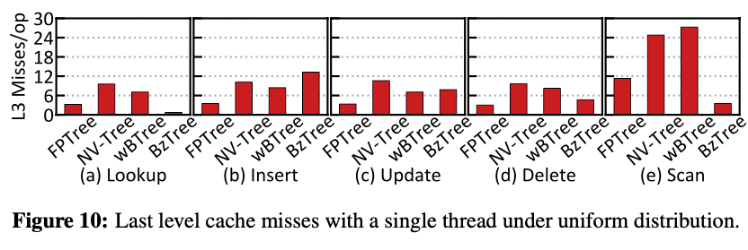
Single-thread - Lookup
Lookup
Inner nodes in DRAM (FPTree and NV-Tree) achieve higher throughput than trees that are fully PM based (BzTree and wBTree). Fig 7a & 8a
FpTree reduce cacheline access; (with NvTree)
FpTree show less Pm Read and cacheline miss the NV-Tree @ Fig 9(a) 10(a)
BzTree incur few cache miss (1K page) Fig 10(a)
BzTree (linear search) better than wBtree(binary search) , [price of PM] Fig7a
NV-Tree show more DRAM read than FPTree (Fig9a);
NV-Tree incur write fro read;(lock in leaf node)
Loopup performance Strongly impacts the other operations.

Slide 9
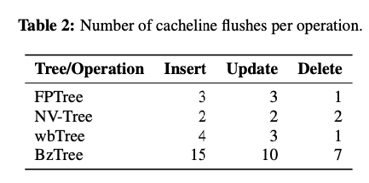
Single-thread - Insert
Insert

Slide 10
Single-thread - Update
Insert

Slide 11
Single-thread - Scan
Insert

Slide 12
Single-thread - Skewed Access
Insert

Slide 13
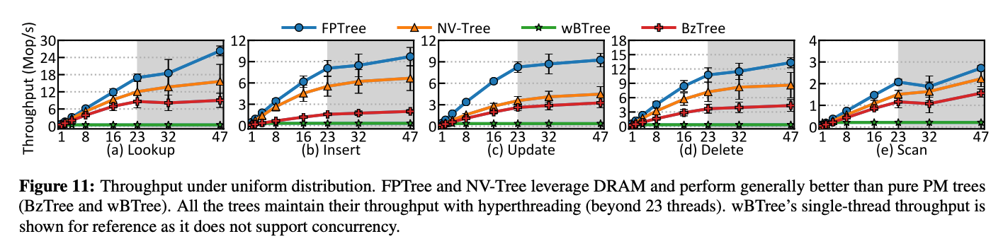
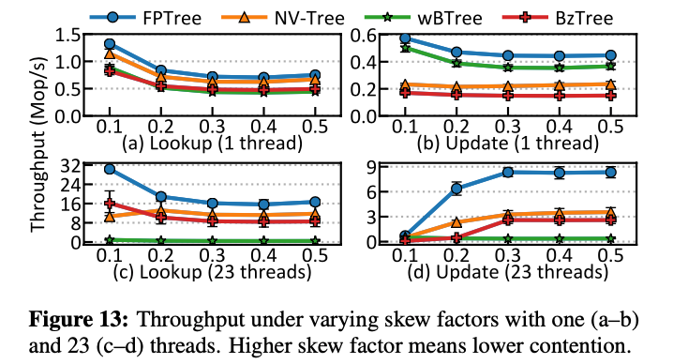
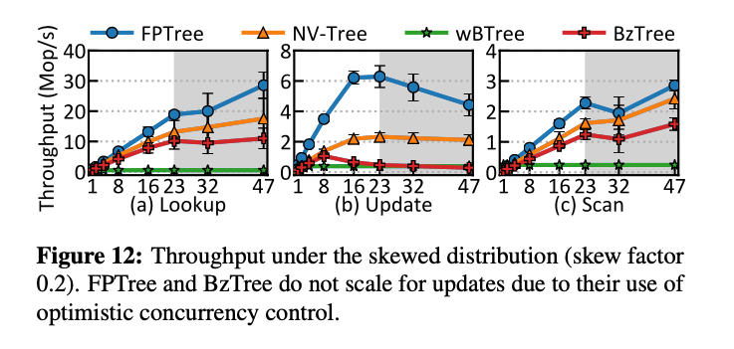
Multi-thread

Slide 14
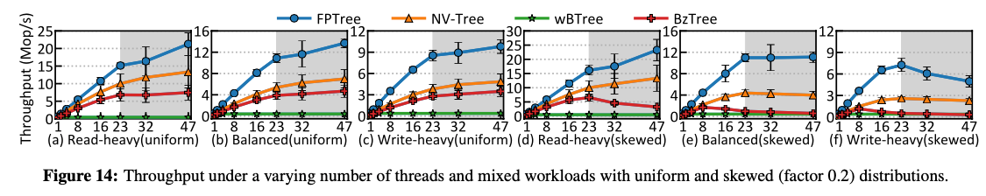
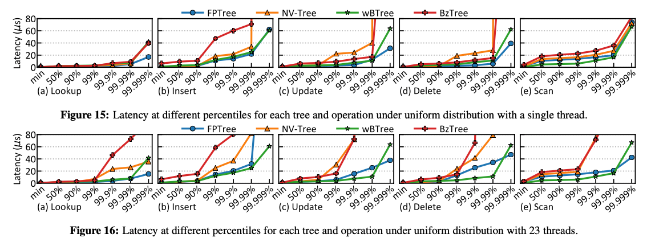
Mixed-Workload & Tail latency

Slide 15
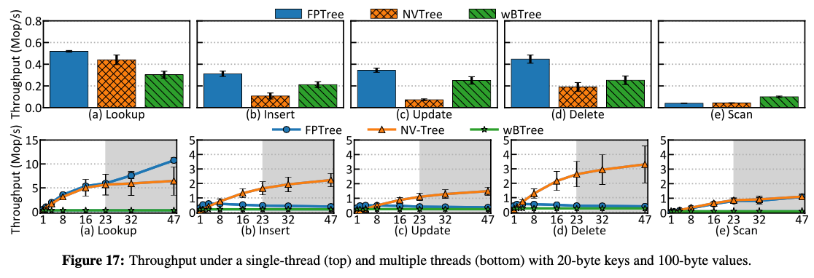
Long Key and Values

